Slide 1

Welcome to Data Science and Machine Learning
Waseem Ahmad Chishti

Slide 2
What is data science?
Data Science=
statistics +
data processing +
machine learning +
scientific inquiry +
visualization +
business analytics +
big data +
Natural Language Processing+
Social Network Analysis+
……

Slide 3
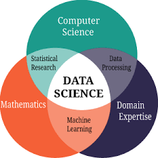

Slide 5
Data Preprocessing
Data Wrangling
Key Stages to Data Wrangling
Data Preprocessing
Data Preprocessing Steps

Slide 6
Data wrangling is the process of cleaning and unifying messy and complex data sets for easy access and analysis.

Slide 7
The key steps to data wrangling:
Data Acquisition: Identify and obtain access to the data within your sources
Joining Data: Combine the edited data for further use and analysis
Data Cleansing: Redesign the data into a usable/functional format and correct/remove any bad data.
Data profiling is the process of examining the data available from an existing information source (e.g. a database or a file) and collecting statistics or informative summaries about that data. The purpose of these statistics may be to: Find out whether existing data can be easily used for other purposes.

Slide 8
Data preprocessing
Why preprocessing ?
70% TIME NEED TO BE PREPROCESS THE DATA
Real world data are generally
Incomplete: lacking attribute values, lacking certain attributes of interest, or containing only aggregate data
Noisy: containing errors or outliers
Inconsistent: containing discrepancies in codes or names

Slide 9
Tasks in data preprocessing
Data cleaning: fill in missing values, smooth noisy data, identify or remove outliers, and resolve inconsistencies.
Data integration: using multiple databases, data cubes, or files.
Data transformation: normalization and aggregation.
Data reduction: reducing the volume but producing the same or similar analytical results.
Data discretization: part of data reduction, replacing numerical attributes with nominal ones.

Slide 10
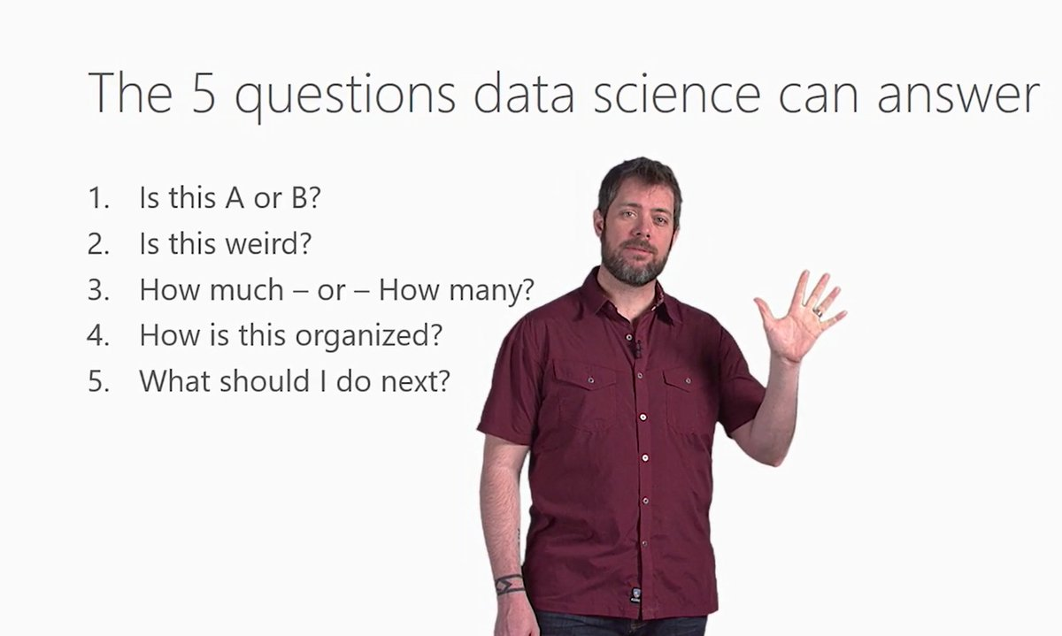

Slide 11
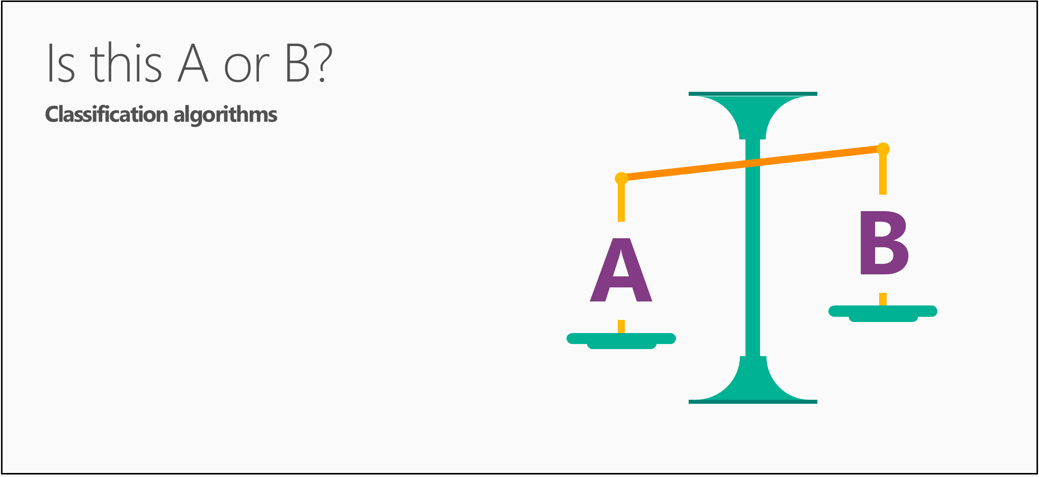

Slide 12
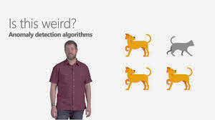

Slide 13
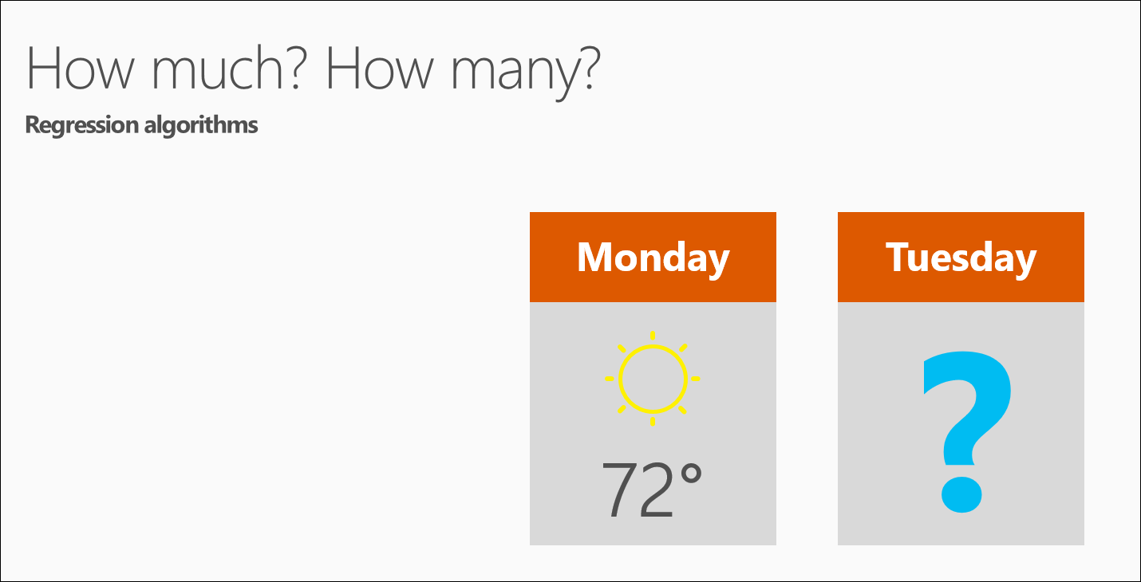

Slide 14
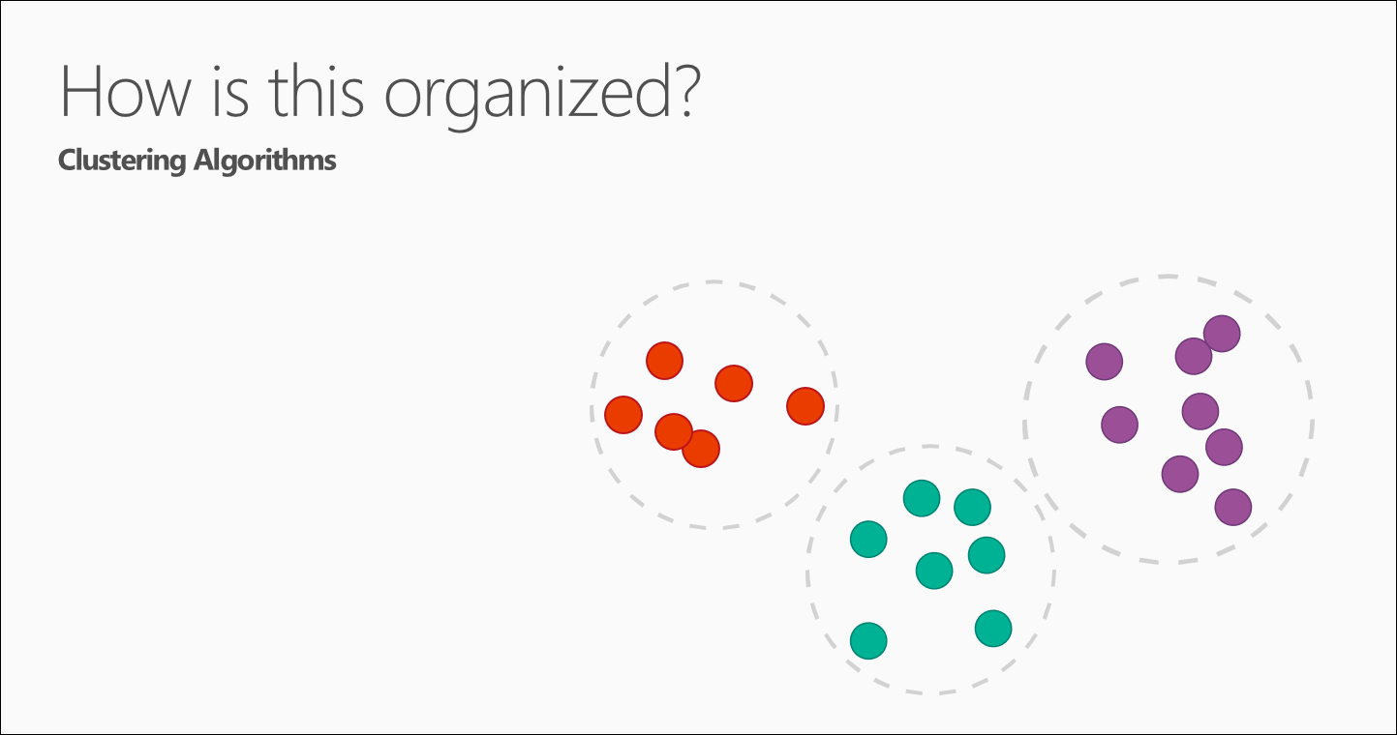

Slide 15
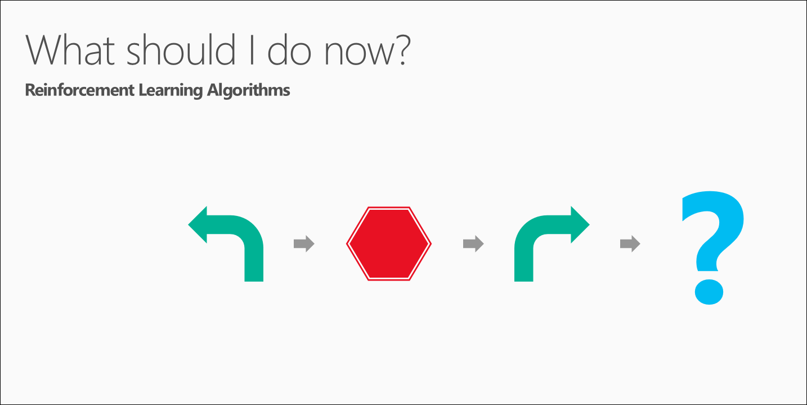

Slide 17
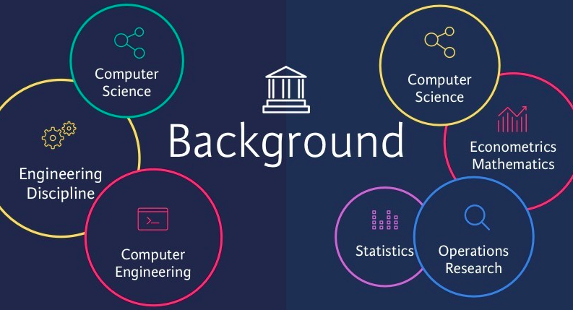
Who can start carrier in data science…?

Slide 18
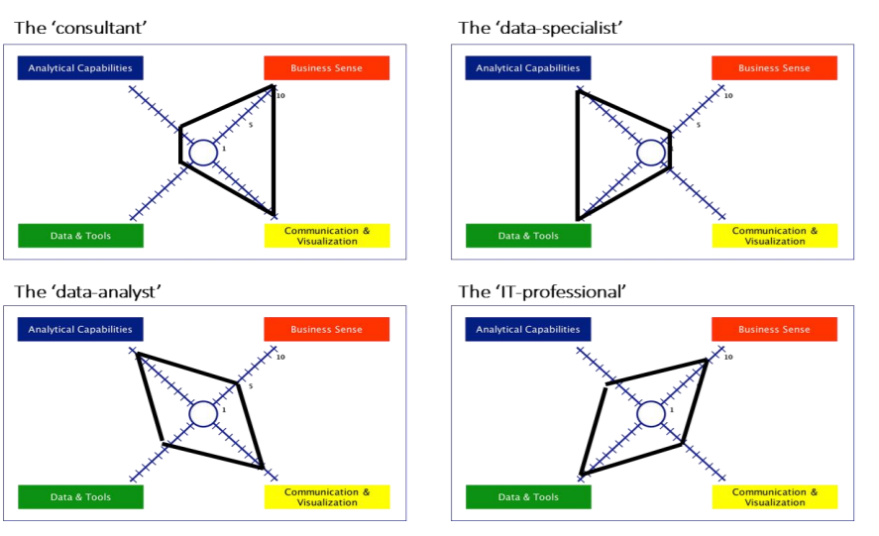
Different profiles of the Big Data Scientist

Slide 19
“Data is the New Oil” World Economic Forum 2011

Slide 20
The Goal of Data Science
Turn data into data products
What about data products….???

Slide 21
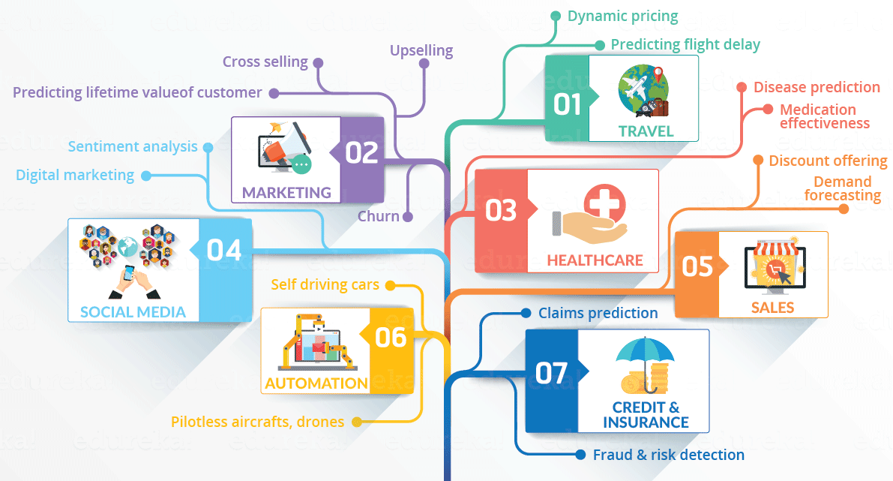

Slide 22
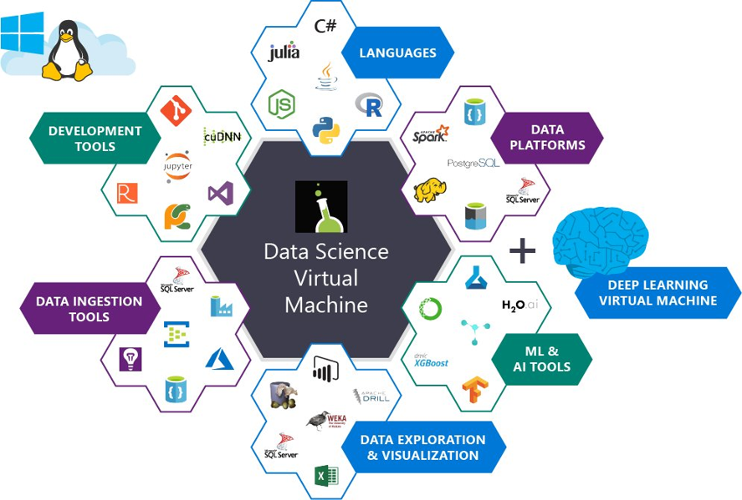
Data Science Tools

Slide 23
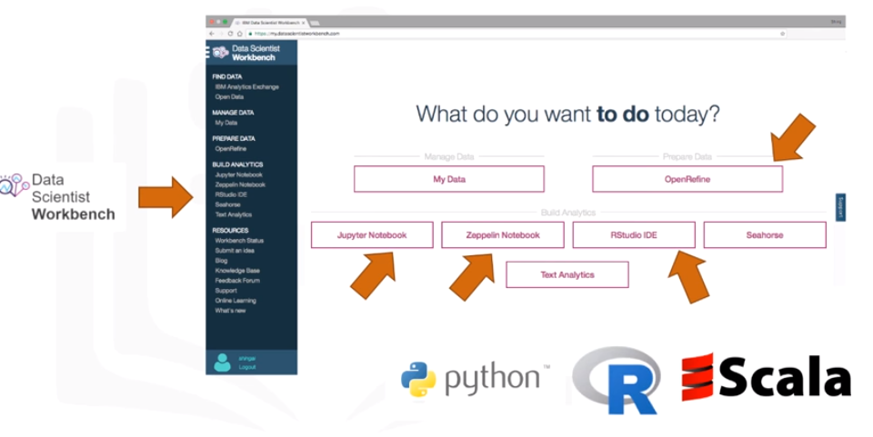
Data scientist workbench

Slide 24
Data Science Applications
•Transaction Databases
Recommender systems (NetFlix)
Fraud Detection (Security and Privacy)
•Wireless Sensor Data
Smart Home
Real-time Monitoring
Internet of Things
•Text Data
Social Media Data
Product Review and Consumer Satisfaction (Facebook, Twitter, LinkedIn)
E-discovery
•Software Log Data
Automatic Trouble Shooting (Splunk)

Slide 25
Data Science Job Growth
The Sexiest Job of 21st Century (Harvard Review)
The America will face 150,000 data scientist shortage in 2020.

Slide 26
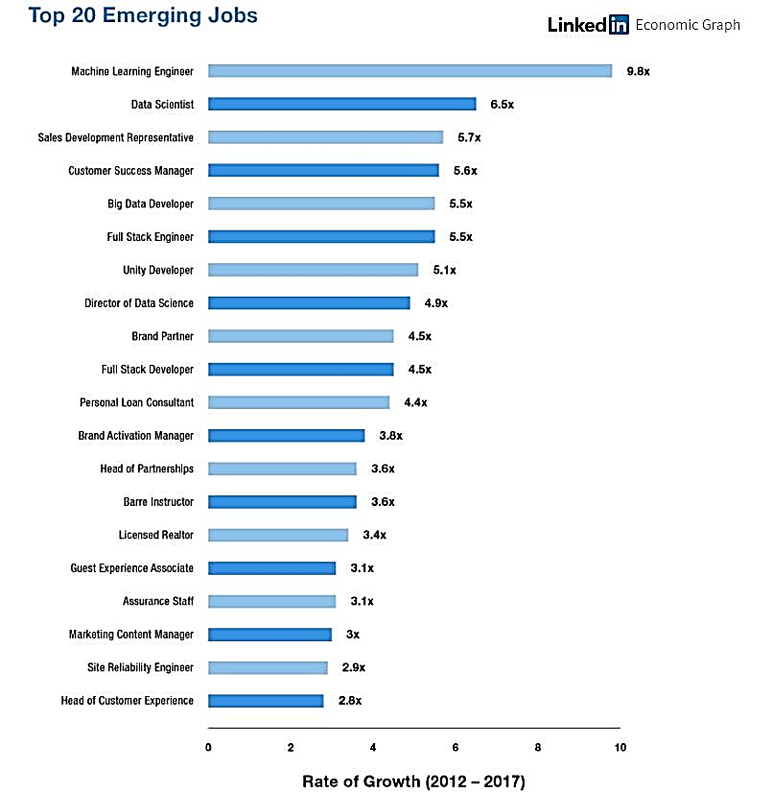
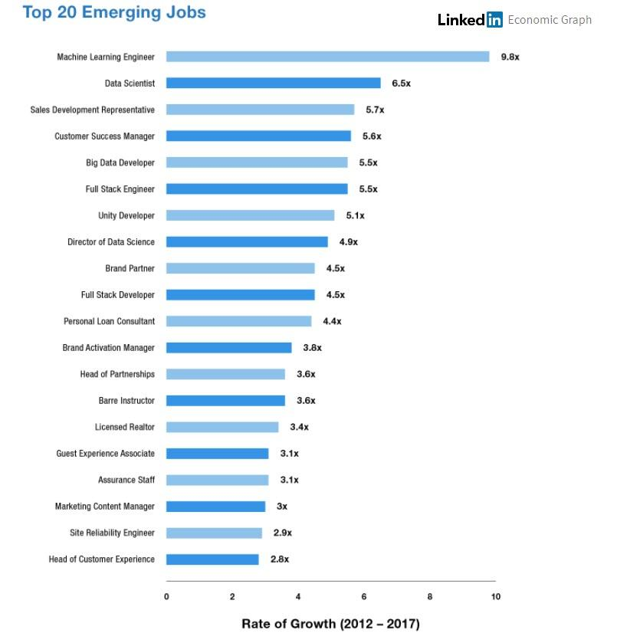

Slide 27
Machine - - Data Science -- Human

Slide 28
What is Machine Learning
Machine learning is the semi automated extraction of knowledge from data
.1 Knowledge from data: Start from question that might be answerable.
.2 Automated Extraction: A computer proceeds the insights.
.3 Semiautomated: Requires many smart decision by a human.

Slide 29
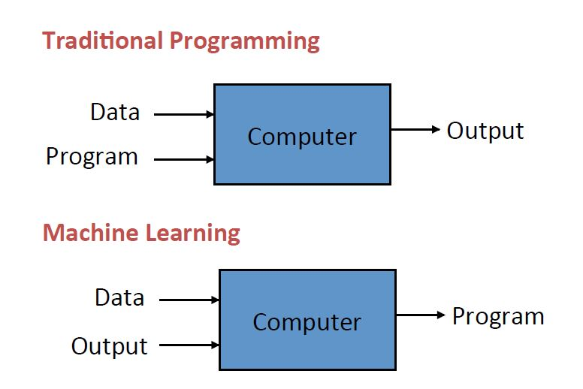
What is Machine Learning

Slide 30
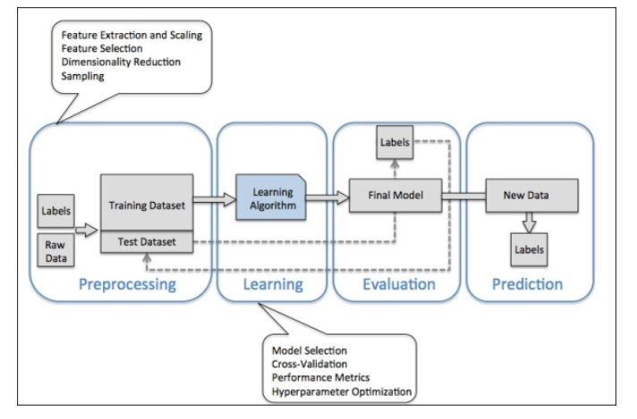
What is Machine Learning

Slide 31
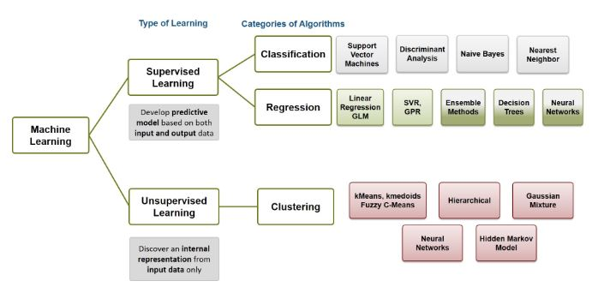
Types of Machine Learning

Slide 32
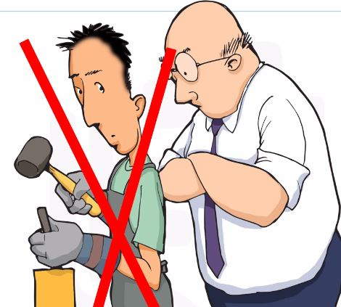
Machine Learning Supervised Learning:

Slide 33
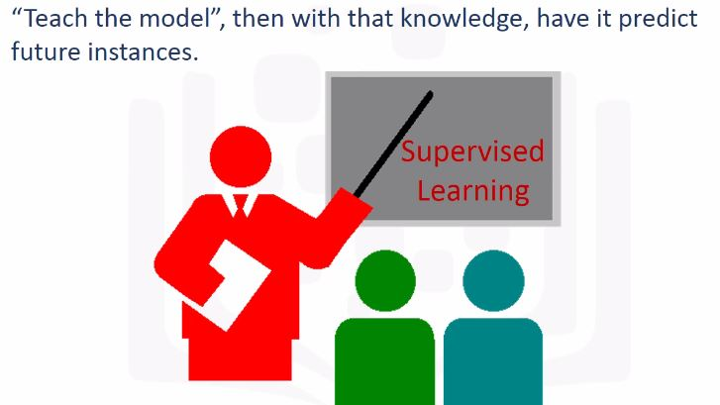
Machine Learning Supervised Learning:

Slide 34
Machine Learning Un-Supervised Learning:
Convert Speech to Text
Social Network Analysis
Customer Segmentation

Slide 35
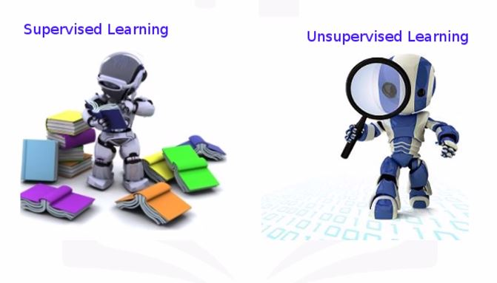
Machine Learning

Slide 36
Types of Machine Learning
Semi-supervised Learning
This kind of learning is used and applied to the same kind of scenarios where supervised learning is applicable. However, one must note that this technique uses both unlabeled and labeled data for training. Ideally, a small set of labeled data, along with a large volume of unlabeled data is used, as it takes less time, money and efforts to acquire unlabeled data. This type of machine learning is often used with methods, such as regression, classification and prediction. Companies that usually find it challenging to meet the high costs associated with labeled training process opt for semi-supervised learning.
Protein Sequence Classification
Speech Analysis
Web Content Classification

Slide 37
Types of Machine Learning
Reinforcement Learning – This type of learning uses three components namely – agent, environment, action. An agent is the one that perceives its surroundings, an environment is the one with which an agent interacts and acts in that environment. The main goal in reinforcement learning is to find the best possible policy.
This is mainly used in navigation, robotics and gaming. Actions that yield the best rewards are identified by algorithms that use trial and error methods. There are three major components in reinforcement learning, namely, the agent, the actions and the environment. The agent in this case is the decision maker, the actions are what an agent does, and the environment is anything that an agent interacts with. The main aim in this kind of learning is to select the actions that maximize the reward, within a specified time. By following a good policy, the agent can achieve the goal faster.
Hence, the primary idea of reinforcement learning is to identify the best policy or the method that helps businesses in achieving the goals faster. While humans can create a few good models in a week, machine learning is capable of developing thousands of such models in a week.

Slide 38
Reinforcement Learning Examples
Autonomous Vehicle
Credit Assignment
Google Go Play
Robotics
Manufacturing
Etc,

Slide 39
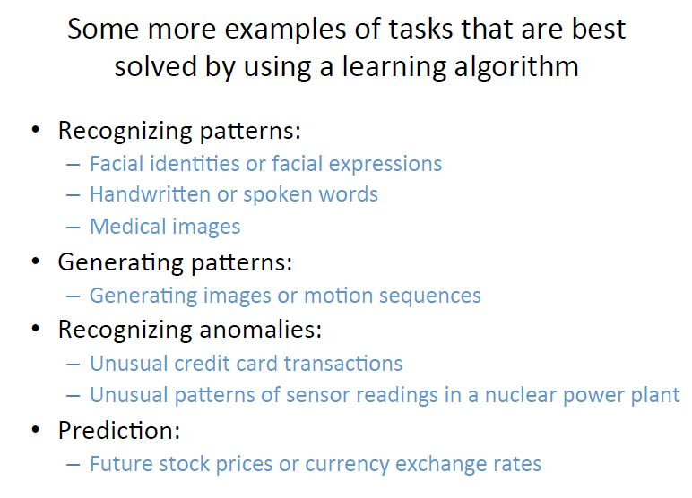
Machine Learning

Slide 40
Requirement of creating good machine learning system
Data – Input data is required for predicting the output.
Algorithms – Machine Learning is dependent on certain statistical algorithms to determine data patterns.
Automation – It is the ability to make systems operate automatically.
Iteration – The complete process is iterative i.e. repetition of process.
Scalability – The capacity of the machine can be increased or decreased in size and scale.
Modeling – The models are created according to the demand by the process of modeling.

Slide 41
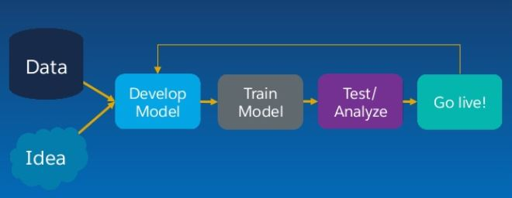
Work of Machine Learning

Slide 42
Lets Play with Machine Learning

Slide 43
Types of Data
Structured Data
Unstructured Data
Semi Structured Data

Slide 44
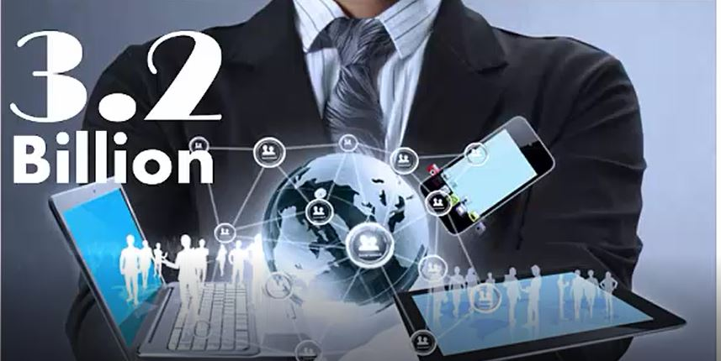
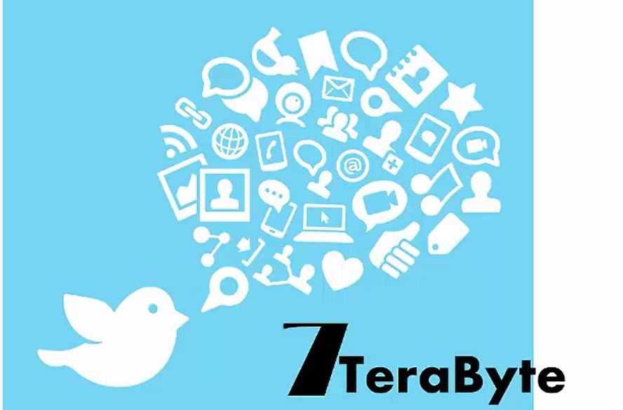

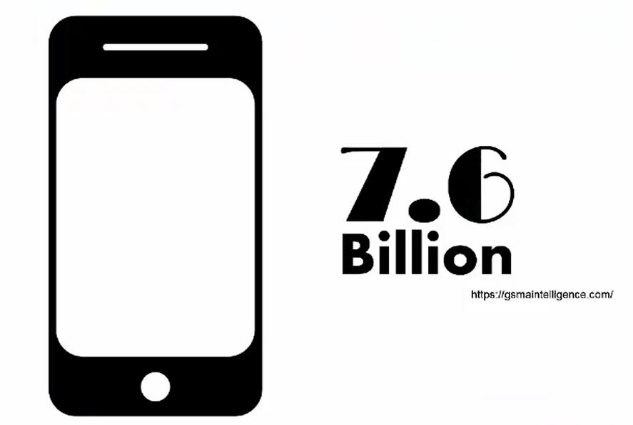
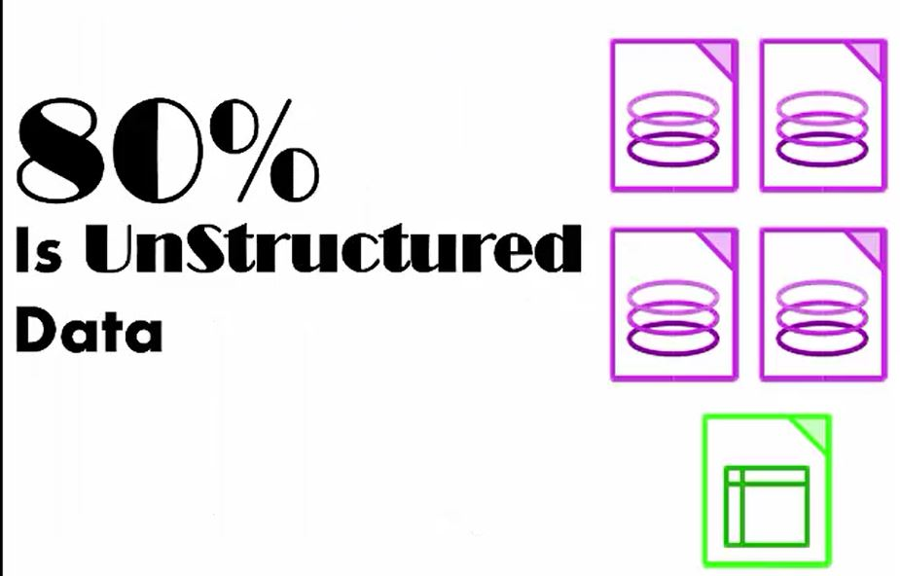

Slide 45
Big Data
That was Deming, I had to look him up.
- Big data is a lot of data.
- Big data is an amount of data that you cannot process.
- Big data is any amount of data that can't fit in memory. It's an evolving definition that changes with the times.
- Whenever your data set extends beyond the capacity of your systems to store and manipulate, it's big data.
It means that if you have a laptop and your data doesn't fit on your laptop, that's big data for you.
But if you are a very large firm and you've got large clusters of storage space and even then your data exceeds the storage capacity of your systems, then that's big data for you; so big data is not something that you can say, well, 50 gigabytes or 50 petabytes

Slide 46
BEST time for data scientist
In the past the software was expensive, now it's open source and it's free.
In the past we couldn't store large amounts of data, now for a fraction of a cost we can have gazillions of data sets for very low cost. So the tools to work with data,the very availability of data and the ability to store and analyze data, it's all cheap, it's all available,
it's all ubiquitous, it's here, there's never been a better time to be a data scientist.
Bernard Marr (LinkedIn) defines Big Data as :
“The digital trace that we are generating in this digital era. This digital trace is made up of all the data that is captured when we use digital technology. The basic idea behind the phrase Big Data is that everything we do is increasingly leaving a digital trace which we can use and analyze to become smarter. The driving forces in this brave new world are access to ever-increasing volumes of data and our ever-increasing technological capability to mine that data for commercial insights.”

Slide 47
Bigdata definition
The research firm Gartner, defines Big Data as follows:
“Big Data is high-volume, high-velocity, and/or high-variety information assets that demand cost-effective, innovative forms of information processing that enable enhanced insight, decision making and process automation.”
Lisa Arthur, a Forbes contributor, defines Big Data as :
“a collection of data from traditional and digital sources inside and outside a company that represent a source of ongoing discovery and analysis.”
Ernst and Young offers the following definition:
“Big Data refers to the dynamic, large and disparate volumes of data being created by people, tools and machines. It requires new, innovative, and scalable technology to collect, host and analytically process the vast amount of data gathered in order to derive real-time business insights that relate to consumers, risk, profit, performance, productivity management and enhanced shareholder value.

Slide 48
China mobile new York time
4 to 5 TB Data 10 times faster processing cost 1/5
4 to 5 TB 24 hours
Companies using yahoo
Yahoo larger contribution in Hadoop
Google
Amazon
Ebay
Facebook
Twitter

Slide 49
5’V’s of big data
Velocity
Volume
Veracity
Variety
Value

Slide 50
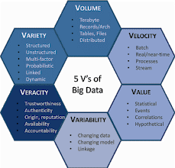
6 V’s of Big Data

Slide 51
Big Data
“Big data is like sex among teens.
They all talk about it but no one really knows what it’s like.” This is how Oscar Herencia,

Slide 52
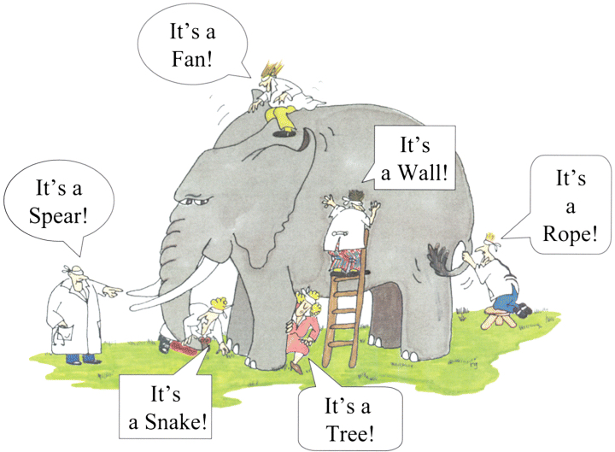
What's driving big data
The blind men and the enormous elephant: the restricted view of each blind man leads to a biased conclusion.

Slide 53
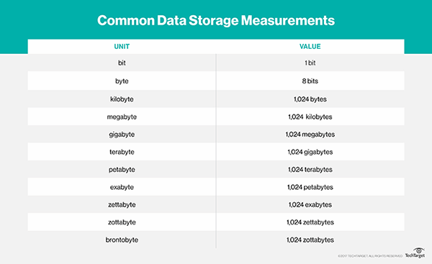
Big Data

Slide 54
Big Data
One gram of DNA can potentially hold up to 455 exabytes of data, according to the New Scientist. For reference: There are one billion gigabytes in an exabyte, and 1,000 exabytes in a zettabyte
Jennifer Walsh:I am currently a genetic counseling student at the Boston University Master's Program in Genetic Counseling. My clinical experience includes preconception, prenatal, pediatric, and cancer genetic counseling. I also have experience working in a molecular diagnostic laboratory.Humans have 46 chromosomes that contain all of the genetic information, and there are over 25,000 genes in the human genome. Genes are composed of DNA, and it is predicted that there are over 3 billion basepairs in the human genome. Humans have approximately 10 trillion cells, so if you were to line all of the DNA found in every cell of a human body it would stretch from the earth to the sun 100 times!

Slide 55
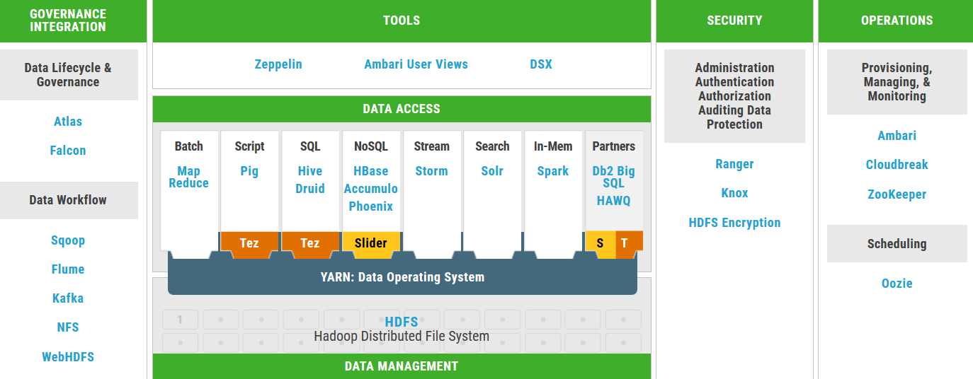
Introduction to HDP/HDF

Slide 57
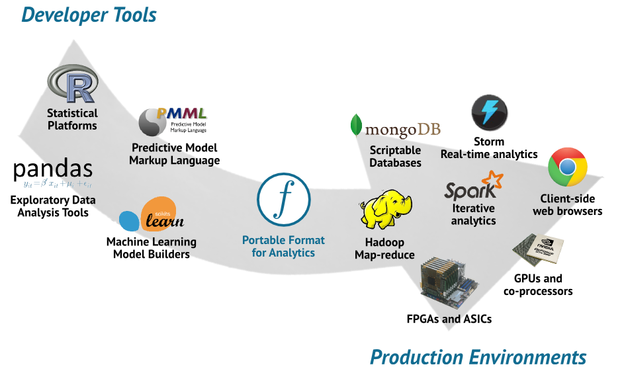
If you are developer

Slide 58
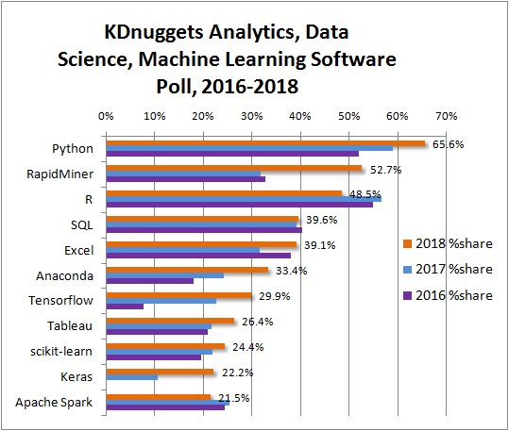

Slide 59
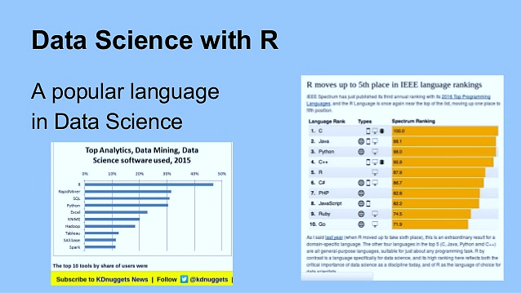

Slide 60
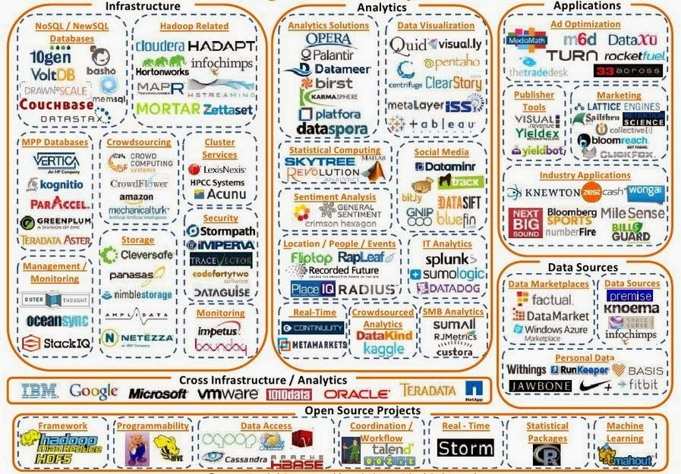
Data Science Tools
http://aifi.io/

Slide 61
Data Science Platform
Github
IBM
Microsoft
Google Research Article
Courrseera
Data Camp
Analytics Vidhiya
Udemy
Udacity
LinkedIn
Towards Data Science
Medium
Hackers Noon

Slide 62
Real World Applications
https://parts-of-speech.info/
http://www.vicarvision.nl/wordpress/claire-1-0-the-virtual-shop-assistant-demo-video-online/
https://voicegender.herokuapp.com/
https://www.babylonhealth.com/
https://www.theguardian.com/sustainable-business/2015/sep/17/ellie-machine-that-can-detect-depression
http://aifi.io/

Slide 63
The End

